Slide 1
March 14, 2024
LEGISLATIVE DISCUSSION

Slide 2
Legislative Panel
Holice Clark, Executive Director
Calumet Memorial Park District
Greg Lewis, CPRP, Executive Dire﻿ctor
New Lenox Community Park District
Kelly Rajzer, Dire﻿ctor
Village of Romeoville Parks and Recreation Department
Tom Hartwig, CPRP, MPA, Executive Dire﻿ctor
Oak Lawn Park District
Shawn Roby, MBA, CPRP, Executive Dire﻿ctor
Tinley Park Park District

Slide 3
SSPRPA Legislative Committee
Members review pending legislation and its impact on Park and Recreation agencies in Illinois, provide suggestions to the Illinois Association of Park Districts, and deliberate on other relevant topics concerning SSPRPA agencies.
Members of This Committee Participate in...
Joint Legislative Committee
IAPD/IPRA Annual Conference Luncheon
Legislative Breakfast
Parks Day at the Capitol

Slide 4
IAPD/IPRA Conference

Slide 5
Joint Legislative Committee (JLC)
Studies existing and proposed state and federal legislation
Recommends initiatives for the legislative platform
Communicates legislative activity and calls for action to IAPD and IPRA members
Conducts grassroots educational programs,
Initiates legislative awareness events
Coordinates activities that increase legislators understanding and appreciation of our members missions and the issues that they confront on a local and state level.

Slide 6
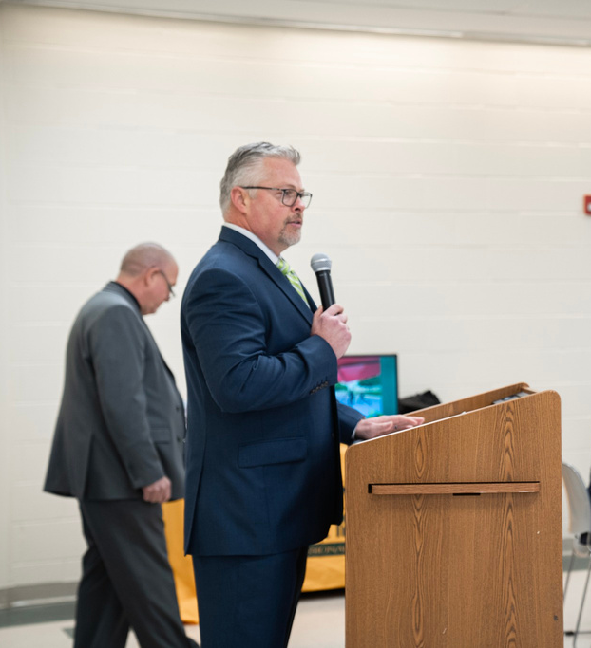
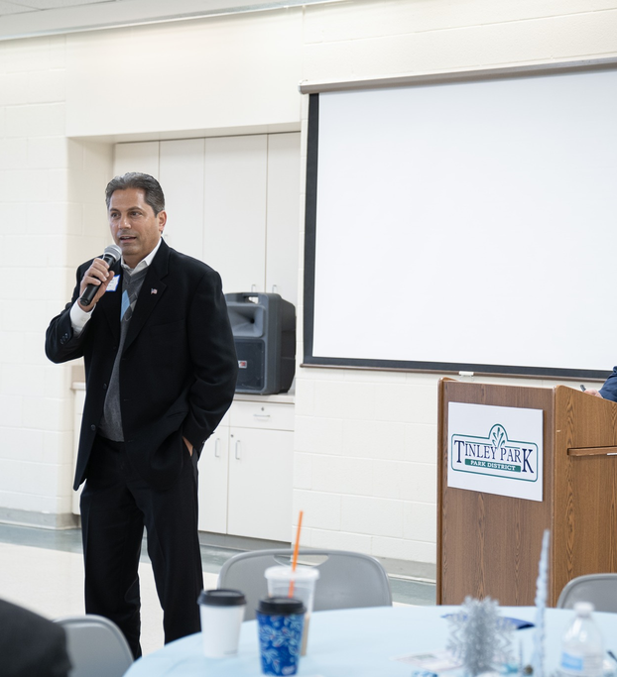
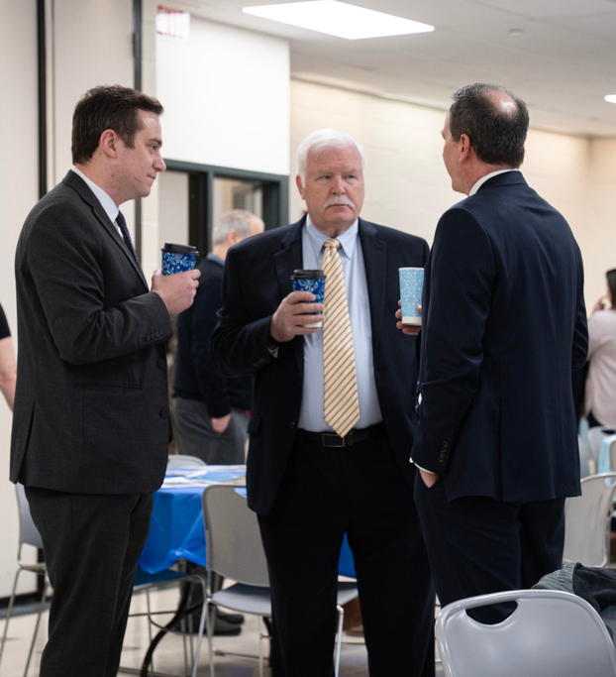
Legislative Breakfast
Joint Legislative Committee Updates
Hear from your local legislators
Understand the Legislative Platform

Slide 8
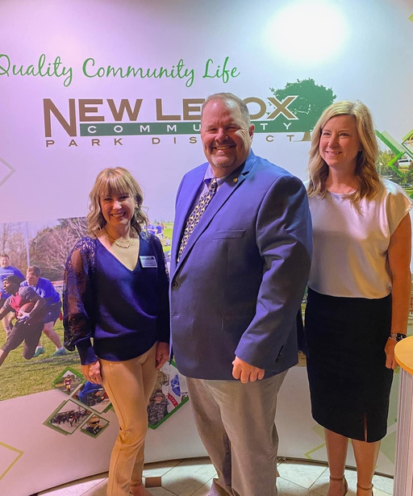
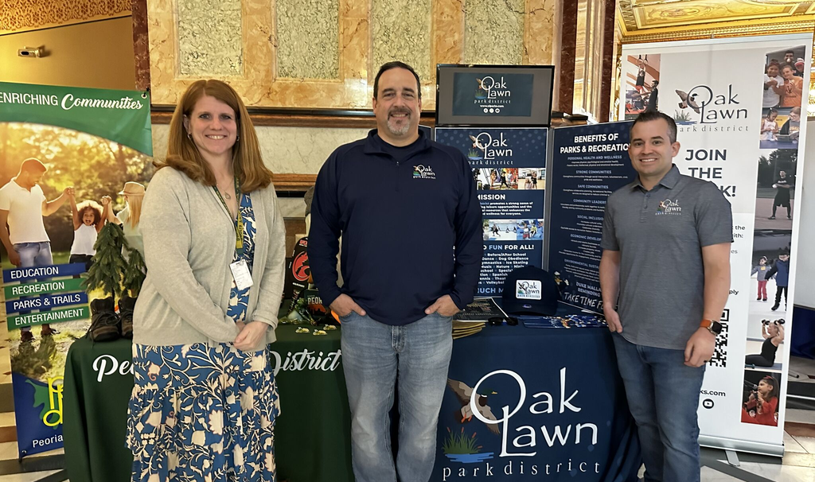
Parks Day at the Capitol
May 7, 2024
llinois State Capitol from 10 a.m. until 2 p.m.
Legislative Reception at the Illini Club
SSPRPA Networking Reception at Maldaner’s
May 8, 2024
Legislative Conference, Crowne Plaza

Slide 9
2023 Legislative
Conference Agenda

Slide 10
QUESTIONS??

